Slide 1
Systems Architecture Training Module
Architecture & Systems Engineering On-the-job Training
Week 1/ Day 2
C.E.S.A.M.E.S. Institut
Version 2 – conforme ASE 2022

Slide 2
course agenda
Introduction
Systems architecture key concepts & framework
Operational architecture and needs engineering
Requirements engineering
Functional architecture
1
2
3
4
5

Slide 3
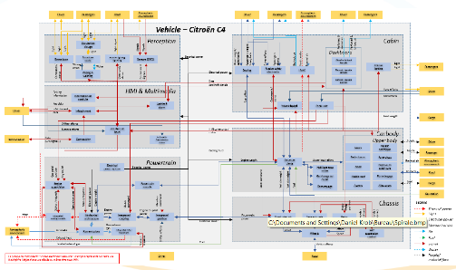

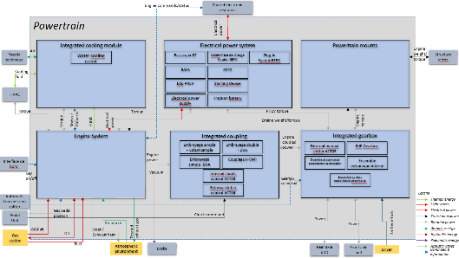
Joint work between designers, geometric and EE representatives
2
At vehicle level, sub-system level 1 or sub-system level 2
System designer
Produces an architecture of the system
That helps refining the requirements
That helps allocating the functions to sub-systems
RAMS designer
Helps the system designer for RAMS related elements
Geometric designer
Requirement
Requirement
Requirement
Function
Sub-system
Breakdown
Requirement
Function
Sub-system
Helps the system designer for geometry related elements
Function
Sub-system
Function
Sub-system
Requirement
Function
Allocation
Sub-system
EE designer
Requirement
Requirement
Breakdown
Helps the system designer for control related elements

Slide 4
course agenda
Introduction
Systems architecture key concepts & framework
Operational architecture and needs engineering
Requirements engineering
Functional architecture
1
2
3
4
5

Slide 5
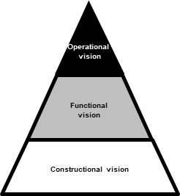
Overview of operational architecture
3
The object under analysis:
The system environment and its constitutive external systems. Each external system belonging to the environment is generally embodied by a stakeholder.
The mission of operational architecture:
Understanding all expected interactions between a system and the external systems in its environment,
Specifying the expected lifecycle phases and associated use cases.
The traditional objectives of operational architecture:
Guarantee a reasonable level of completeness in the identification of needs and organise the methods & the support tools of the repository of needs thanks to knowledge of the environment,
Provide entry points for the functional architecture work as a result of analysis of the operational scenarios associated with the different use cases of a system that describe all of its external interactions.

Slide 6
Course agenda
1
Introduction
Systems architecture key concepts & framework
Operational architecture and needs engineering
3.1 – Environment architecture
3.2 – Lifecycle definition
3.3 – Needs architecture & allocation
3.4 – Use case analysis
Requirements engineering
Functional architecture
2
3
4
5

Slide 7
Environment architecture concept Maximal systemic perimeter
3
Porter forces
Customers
Competition
Suppliers
Law
Technology
Needs
Maximal systemic perimeter
Project system
System of interest
environment
External interface
End-users
Infrastructures
Software subsystems
Hardware subsystems
Information
Data
Other organiational systems
Humanware subsystems
Other technical systems
Système
Energy
Relation, influence, interface, interaction
Maintenance systems
Climate
An example of a generic maximal systemic perimeter of a system. Setting boundaries to the environment of a system should be one of the first architecture tasks.

Slide 8
Beware: avoid confusing product system and project system
3
Project system
Status
Product system
Execution actions
Constructional vision
Work on
Sub-system
Sub-system
Achieve
Implement
Functional vision
Project activity
Project activity
Function
Function
Affect
The project system can be seen as a set of actors or activities improving the maturity of the different architectural layers of the product system.

Slide 9
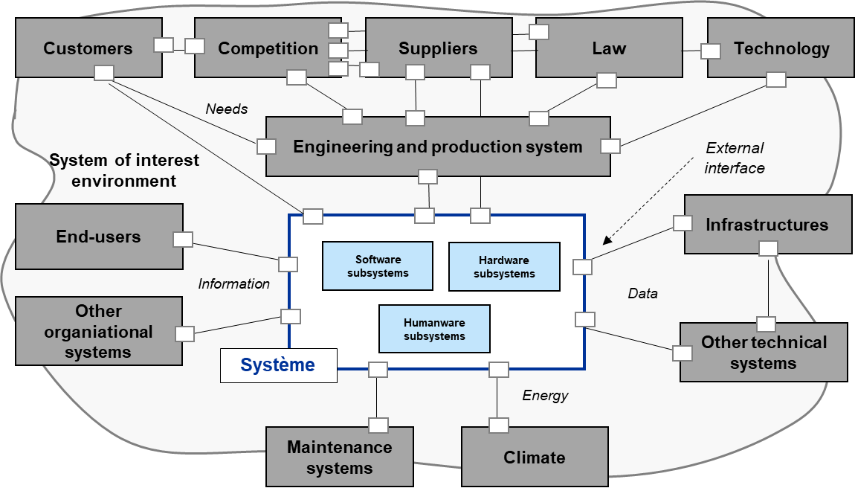
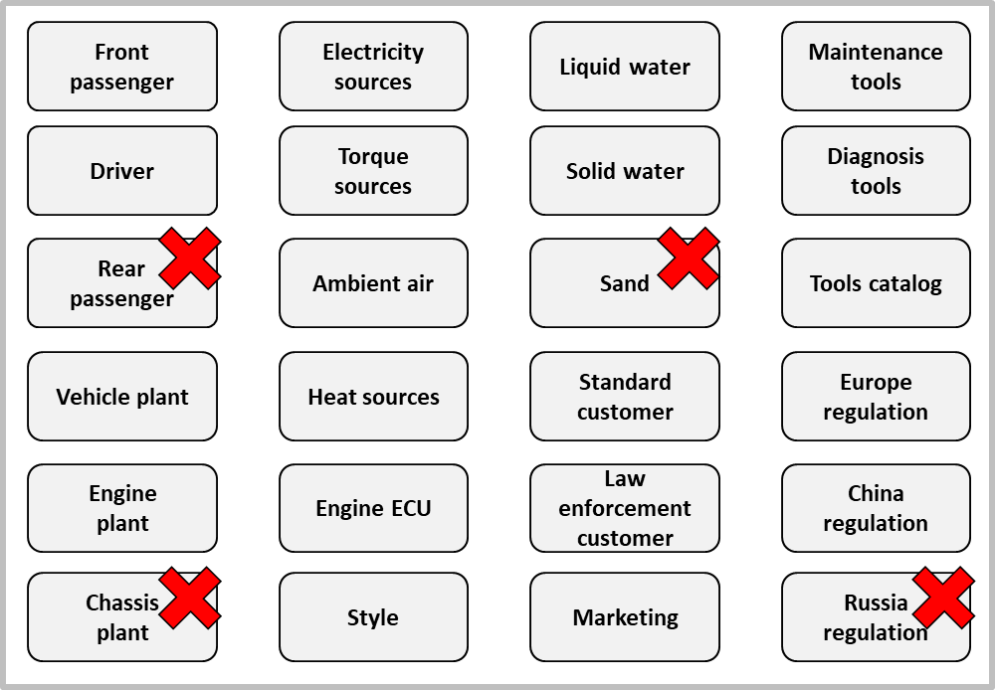
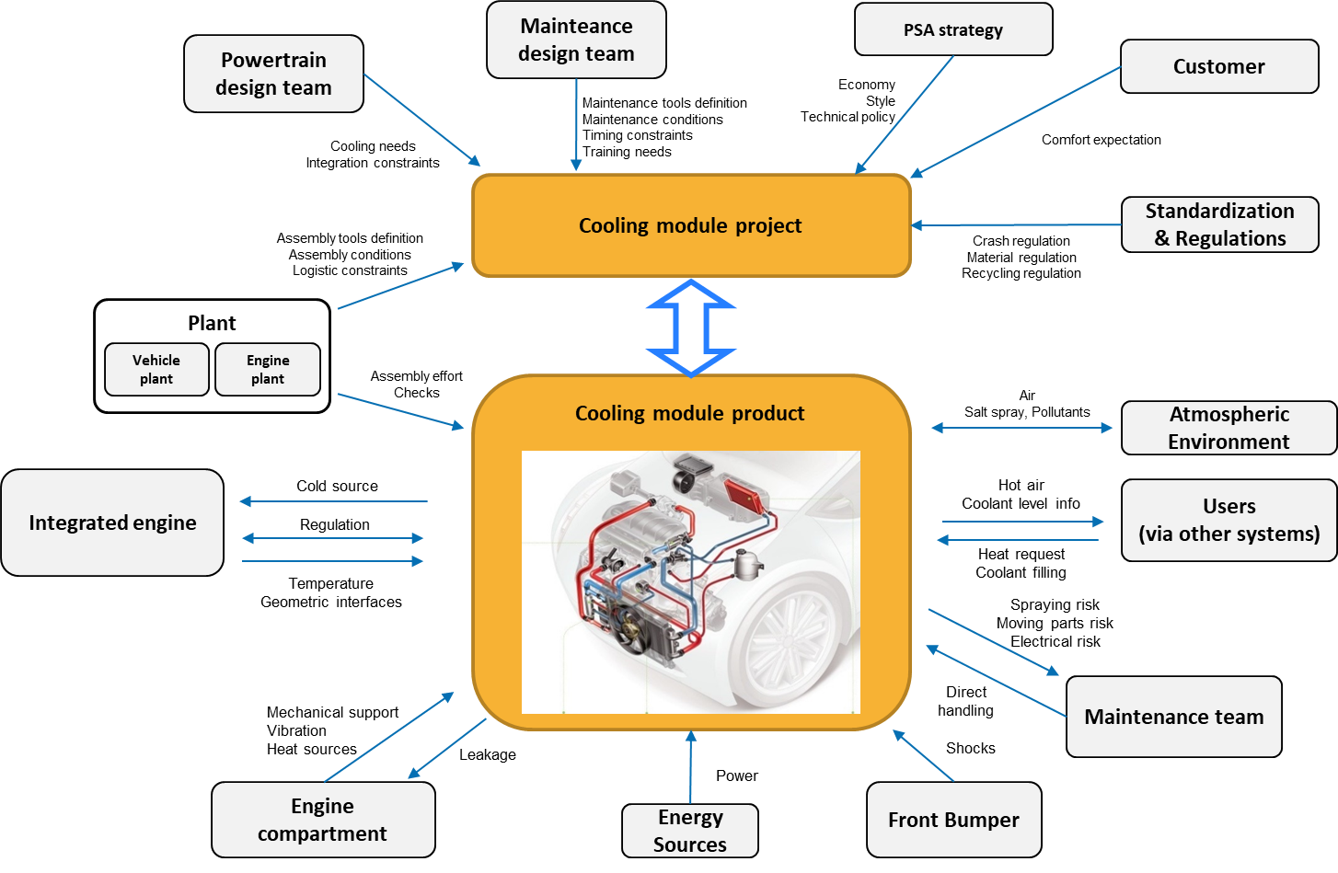
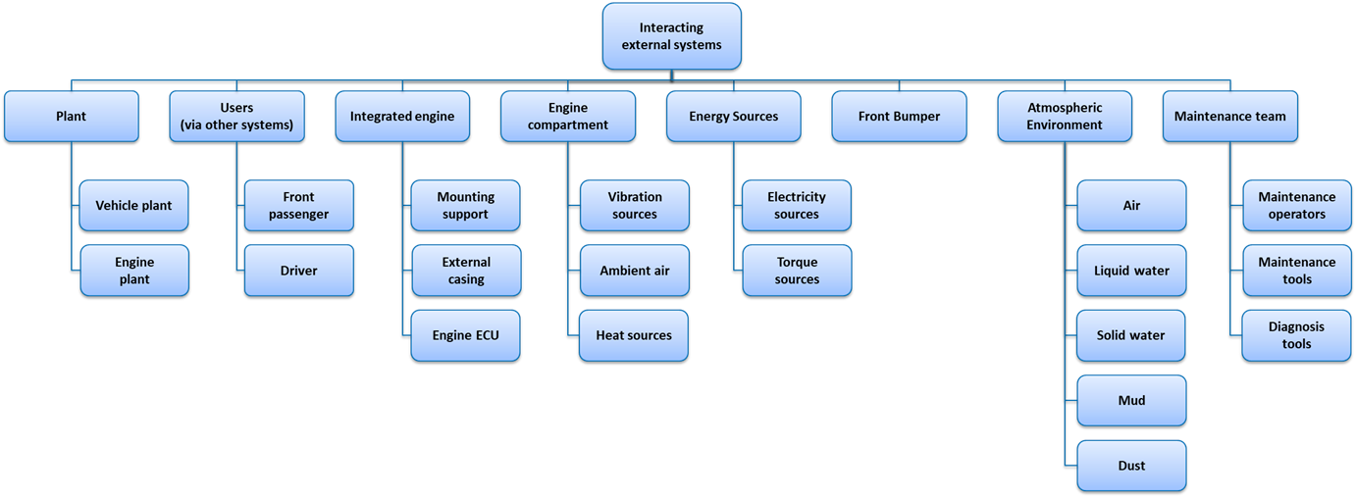
Environment architecture process overview
3
Maximal systemic perimeter
Elimination of non-relevant stakeholders
Step 1
Step 2
Identify maximal systemic perimeter
Identify the system outside
Step 3
Step 4
Organize hierarchically external systems
Identify external interfaces
Stakeholders hierarchy
Identification of flows and exchanges with the outside
Step 5
Specify external interfaces
The main phases of the system environment architecture process

Slide 10
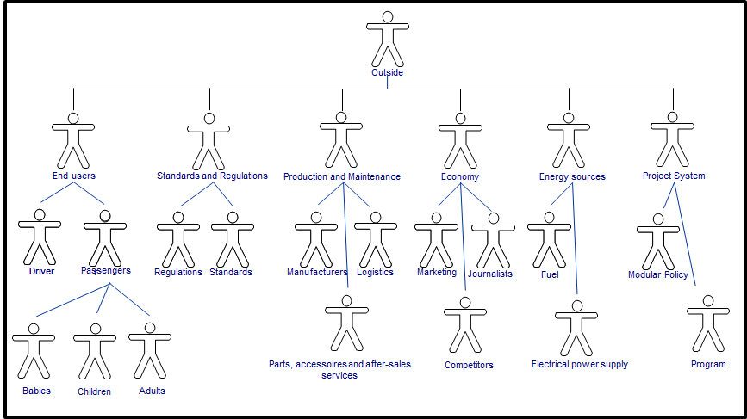
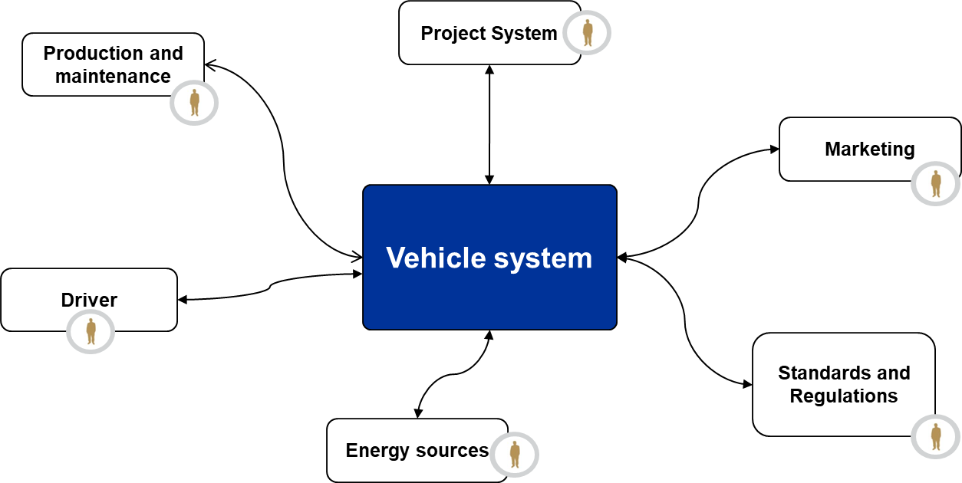
Key deliverables of the environment architecture process
3
External systems hierarchy
Environment diagram
The two key deliverables of the system environment architecture process are external systems hierarchical map and target system external interfaces identification

Slide 11
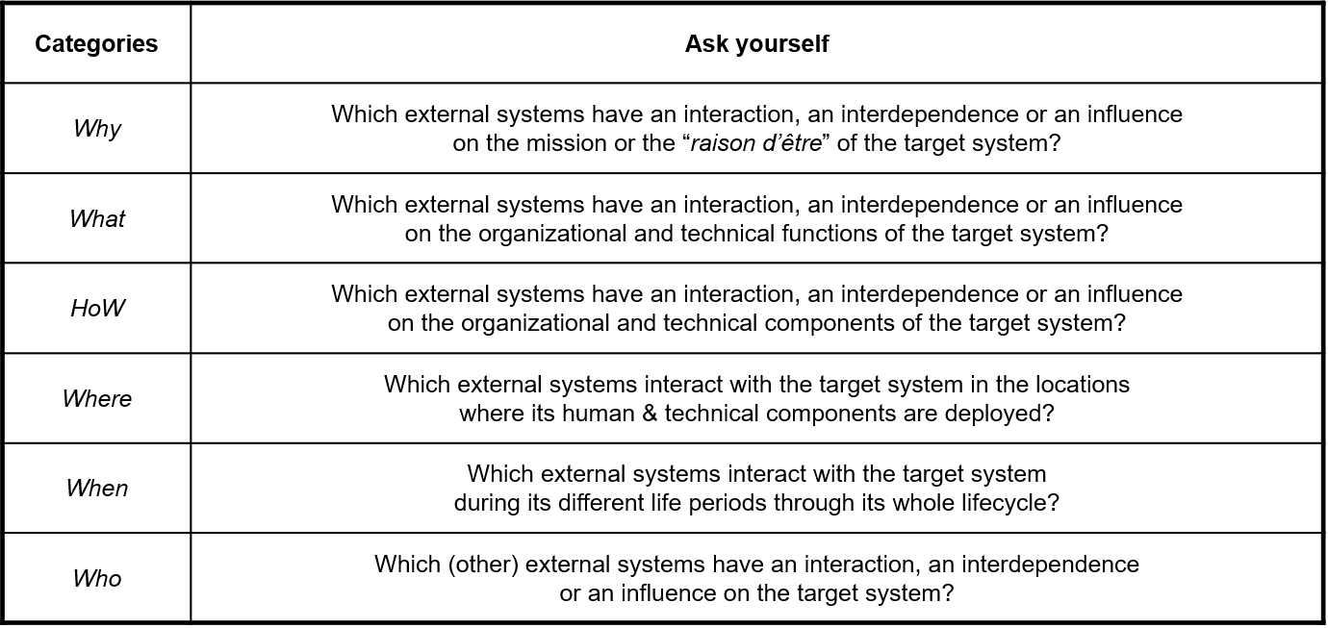
Environment architecture – Step 1: identify maximal systemic perimeter (1/2)
3
A classical method of exhaustive external systems identification:
the 6 « W » method (Why, What, HoW, Where, When, Who)

Slide 12
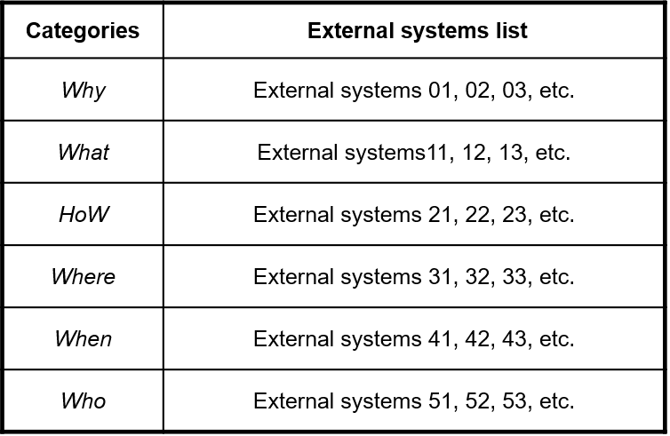

Environment architecture – Step 1: identify maximal systemic perimeter (2/2)
3
Brainstorming, creativity meetings, etc.
Documentation
« tagging»
Documentation analyses
External systems list identification
« 6 W » method in practice: explore system outside through creativity meetings, brainstorming sessions , documentation analyses, interviews, etc. In case of a component design, the vehicle environment diagram and the components architecture of the vehicle are also major inputs sources

Slide 13
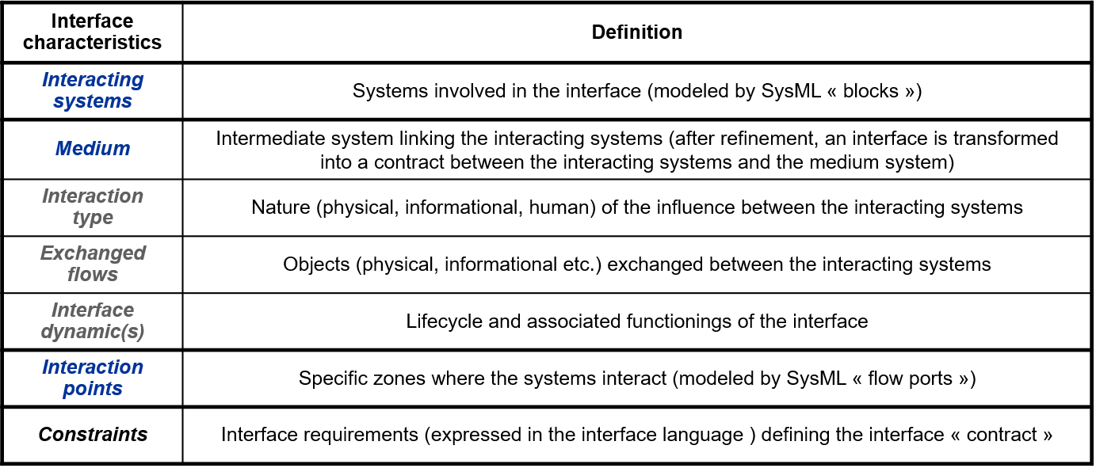
Environment architecture – Step 5: specify external interfaces (1/2)
3
System A
System B
Flows exchanged
Key generic features of an interface

Slide 14

Environment architecture – Step 5: specify external interfaces (2/2) Example of the external interface between a car and a gas station
3
Interface characteristics | Interface between fuel nozzle and car
Interacting systems | Car, fuel, fuel nozzle
Medium | fuel nozzle
Interaction type | Mechanical & chemical interactions
Exchanged flows | Fuel, gas & forces
Interface lifecycle | Interface access granted/not granted, fuel nozzle present/not present, fuel present/not present, …
Nominal operation | Plug the fuel nozzle onto the car and refuel
Abnormal operation | Fuel reflux, fuel tank blocked of choked
Interaction points | Fuel tank filling neck (inner), fuel nozzle (outer)
Constraints | The interface shall allow air flow to pass in order to equilibrate inner and outer pressure The interface shall withstand the lever induced by the fuel system
Each external interface of the target system shall be precisely described

Slide 15
Course agenda
1
Introduction
Systems architecture key concepts & framework
Operational architecture and needs engineering
3.1 – Environment architecture
3.2 – Lifecycle definition
3.3 – Needs architecture & allocation
3.4 – Use case analysis
Requirements engineering
Functional architecture
2
3
4
5

Slide 16
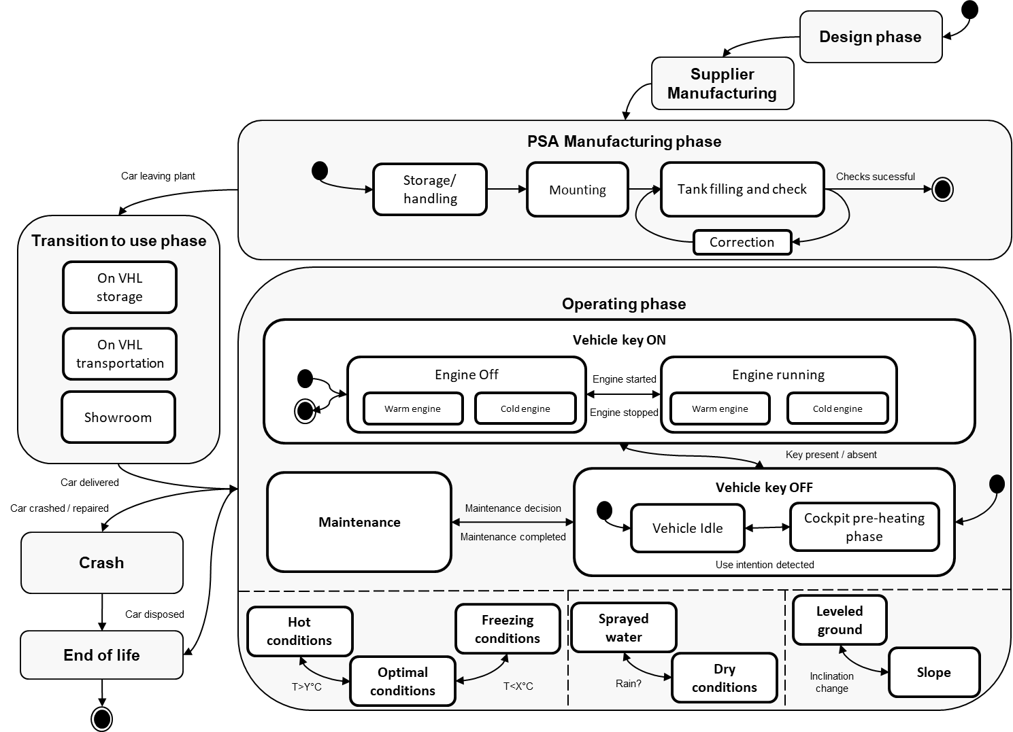
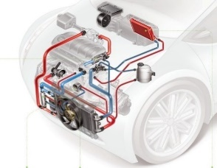
Lifecycle definition concepts Lifecycle & lifecycle phase
3
Events that trigger « immediately » an lifecycle phase change
Integrated cooling module
Concurrent phases (i.e. in which the system can be at a same moment)
Lifecycle phases modeled by states (of a state diagram)
The system lifecycle is the synthesis of its lifecycle phases, namely its life periods as perceived by its environment (customers, end-users, supporting systems, technical infrastructures, etc.) when the exchanges or use made with the system are stable

Slide 17
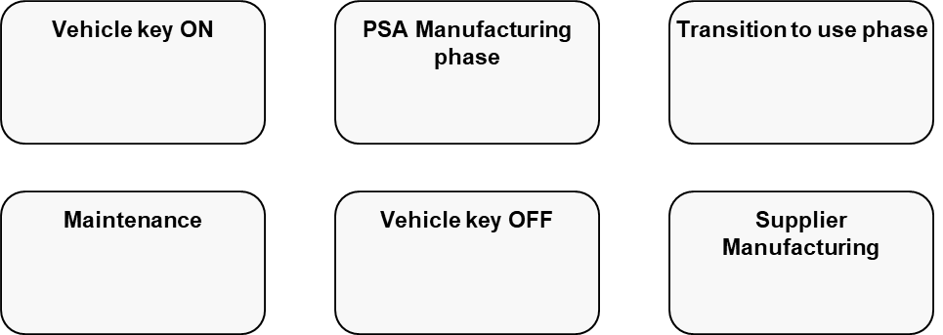
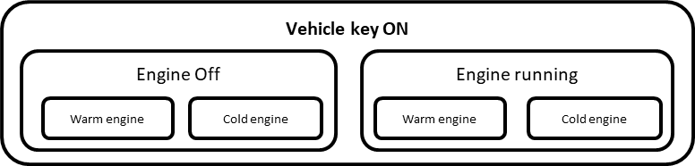
Lifecycle definition process overview (2/2)
3
Step 1
Lifecycle phases
Step 2
Organized lifecycle phases
Identify
lifecycle phases
Organise
lifecycle phases
Mature lifecycle diagram
Step 4
Preliminary lifecycle diagram
Step 3
Cross check with environment and needs
Identify events
The lifecycle definition process intends to identify exhaustively the lifecycle phases of a given system

Slide 18
Lifecycle definition process overview (1/2)
3
1
States / events
Generic situation 2
Generic situation 1
Event
Generic situation2.1
Generic situation 2.3
Event
Generic situation 1
Event
Time
Event
…
Generic situation 2.2
2
Use case
Operational
scenario
3
Zoom on a lifecycle state modeling an lifecycle phase
The lifecycle definition process allows to define the system lifecycle and its operational scenarios, which are the « entry points » for the functional analysis by:
defining the system lifecycle
defining a use case for each lifecycle phase involved in the system lifecycle
analyzing the dynamic behavior of each use case by mean of an operational scenario
Use cases and operational scenarios will be studied on day 4.

Slide 19
Course agenda
1
Introduction
Systems architecture key concepts & framework
Operational architecture and needs engineering
3.1 – Environment architecture
3.2 – Lifecycle definition
3.3 – Needs architecture & allocation
3.4 – Use case analysis
Requirements engineering
Functional architecture
2
3
4
5

Slide 20

Overview of needs & requirements on a given system
3
Be careful to the relativity of the point of views: a requirement on an external system is a need relatively to the system of interest
Environment
Outside of the vehicle
Missions
1
Needs
Extended Vehicle
Operational level
Outside
Missions
Derivation
relationships
Inside
Function 1
2
Functional requirements
Allocation relationships
Function 2
Functional level
Functions
Function 3
Function 4
Derivation
relationships
Allocation relationships
People
Software & hardware components
3
Organizational requirements
Logiciels
Matériels
Technical requirements
4
Components
Constructional
level
Constructional requirements
In order to fulfill to the needs coming from the external systems of its environment (1), the vehicle shall behave in a certain way (2) and be structured in a certain manner (3-4).

Slide 21
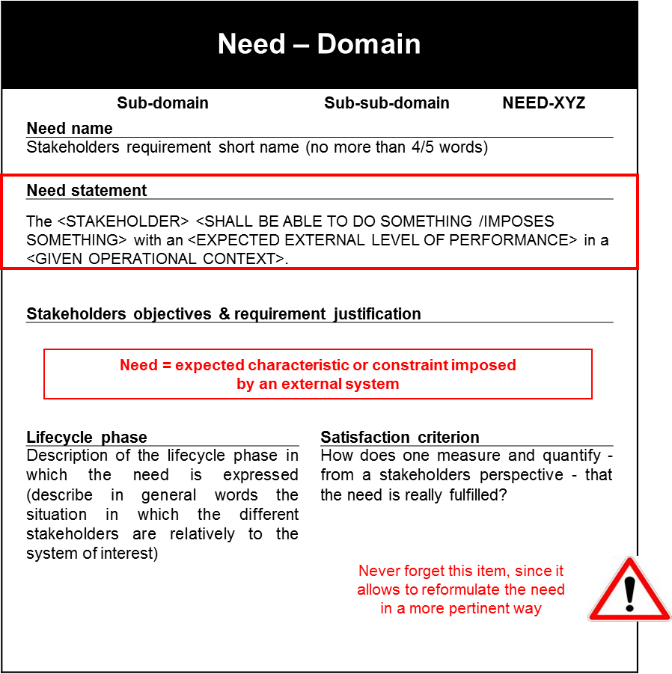
Need template
3
A domain corresponds to a « relevant » set of external systems and/or stakeholders
Need – Domain
Need template that shall be respected
Need = expected characteristic or constraint imposed
by an external system
Never forget this item, since it allows to reformulate the need in a more pertinent way

Slide 22
Typical categories of needs
3
Types of requirements on an industrial system
O | Operability | Capability of being easily used by end-users, operators & technicians
A | Availability | Capability to remain in normal operational conditions (synthesizes maintainability & reliability)
P | Performance | Capability of ensuring specific services levels and/or economical objectives
S | Safety (resp. security) | Capability of functioning without (resp. with) negative impacts on (resp. from) the outside of the system
E | Evolutivity & durability | Capability of evolving among time and adapting to new stakeholders requirements
T | Transparency | Capability of reporting the internal views of the system of interest to the outside
Types of stakeholders requirements on an industrial system |  | Corresponding external systems
P | Political | Political system
E | Economical | Economical system
S | Social | Society
T | Technological | Technological innovation system
E | Environmental | Earth
L | Legal | Legal & regulatory system
Some typical categories of needs

Slide 23
Needs architecture – Step 1: identify the needs capture methods
3
Stakeholders
Project System
Production and maintenance
Brainstor-ming
Interviews
Corpus analyses
Interviews
Data
Data
Economy
Vehicle system
Market research
Data
End users
Services
Market research
Constraints
Energy
Standards and Regulations
Energy sources
Corpus analyses
Corpus analyses
The first activity consists in identifying the methods for capturing needs (interviews with stakeholders, market research or study of a documentary corpus, brainstorming meetings)

Slide 24


Needs architecture – Step 2: capture and formalize the needs
3
Needs capture methods
Stakeholders interviews
Marketing briefing
Brainstorming
Document analysis
Stakeholders
Needs
Need template: The <stakeholder> shall be able to <do something> with an <expected level of performance> in a <given lifecycle phase> .
Analysis grid | Stakeholder | To do something | Level of performance | Lifecycle phase
 | Marketing | guarantee that the “Overall vehicle and front accessibility” service | an overall efficiency mark of X | standard use
Formalized need: <Marketing> shall be able to <guarantee that the “Overall vehicle and front accessibility” service> (Marketing grid § 7) has <an overall efficiency mark of X> in <standard use> .
The second activity consists in formalizing the needs identified via the capture methods identified in the previous activity using a standardized template of needs.

Slide 25

Good practices Needs coverage and consistency checks
3
Operability
Environment analysis show that operability category shall cover:
End-users operability
Technical operability
Maintenance operability
Support operability
…
End-users operability
Technical
operability
Maintenance
operability
Support
operability
Standard tools imposes…
Logistics imposes…
Groupe PSA IT infrastructure imposes…
The driver shall be able to….
Vehicle
The front passenger shall be able to…
The assembly line shall be able to…
Maintenance team shall be able to…
(Partial) needs architecture
Coverage relationships & needs architecture organization principles shall be checked in order to resolve all logical inconsistencies which can lead to reformulate the needs, to identify missing needs and/or to identify new topics

Slide 26
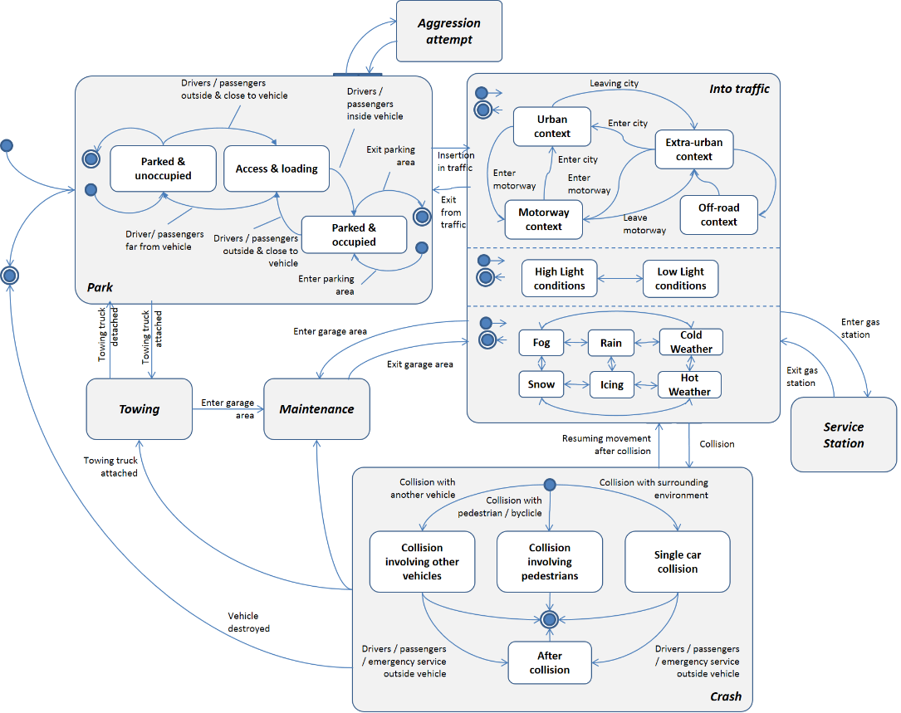
Good practices Cross check analysis between needs and life cycle
3
Identification of the "maintenance" context
The maintenance system shall be able to detect a braking failure when the vehicle is being revised.
1
Outside of the vehicle
Needs
The maintenance system shall be able to tract the vehicle securely when the vehicle is towed to the garage.
2
Vehicle
Identification of a need linked to the "towing" context
Needs engineering
Lifecycle definition
Crossed operational analyses (needs ←→ operational models) must also enable detection of missing elements and alignment of each specification

Slide 27
Main difficulties of needs capture and classification (2/2)
3
Classical difficulty 1: technical intrusion
Context: a stakeholder expresses a need as a requirement: « the system shall … ».
Difficulty: it is impossible to express this need exploiting the proper template
Good practice: try to understand what are the core reasons that are motivating the stakeholder and explore the associated causality chain (you shall find « the cause of the cause » up to 5 iterations …) in order to identify the real source need
Classical difficulty 2: apparent indifference
Context: a stakeholder expresses a need that has apparently no relationships with the system of interest: « Airline pilots shall eat blueberries each day » …
What shall not be done: do not ignore « a priori » that need since it may reveal important information on an “hidden” external influence
Good practice: identify the nature of the interaction and/or interdependency that exists between the stakeholders and the system of interest and verify if a given apparently non relevant need has really an influence on the system of interest.

Slide 28

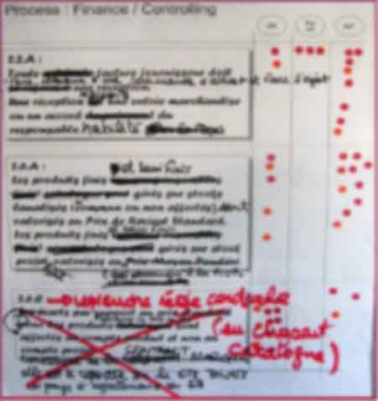

Good practices Share & challenge formalized needs with their stakeholders
3
Remember: the success of a collaborative workshop relies on the capability of gathering together all the stakeholders of the set of needs that have to be shared
NOT OK
To be reformulated
OK
Vote on a set of stakeholders needs in a collaborative workshop
Needs shall be always shared & challenged with all stakeholders in order to be sure that a system design starts on a solid & robust basis
Sharing a set of needs: consensual rewording of contentious items and removal of unshared needs

Slide 29
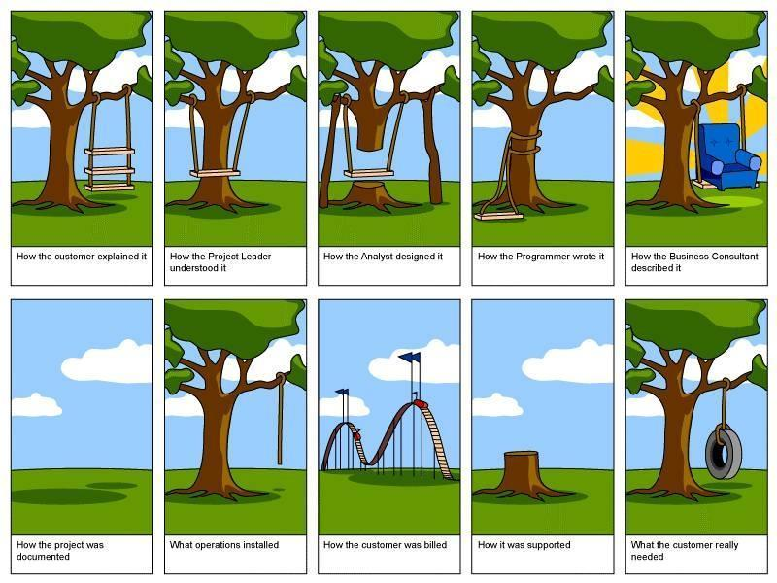
As a conclusion … varied perceptions on a given system
3
Always be in touch with the real needs, all along the development and integration cycle

Slide 30
Course agenda
1
Introduction
Systems architecture key concepts & framework
Operational architecture and needs engineering
3.1 – Environment architecture
3.2 – Lifecycle definition
3.3 – Needs architecture & allocation
3.4 – Use case analysis
Requirements engineering
Functional architecture
2
3
4
5

Slide 31
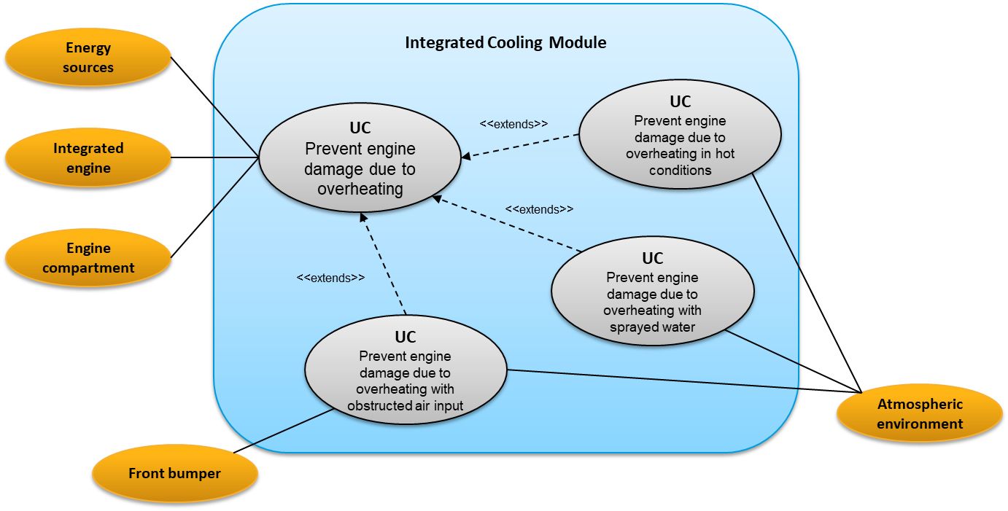
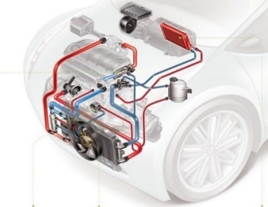
Use case analysis concepts Use case
3
External systems
Lifecycle phase = Vehicle Key On
Activities involving the target system
Integrated cooling module
Target system boundary
A use case is a static specification of a lifecycle phase that describes both all external systems interacting with the system in the considered context and the associated interactions

Slide 32
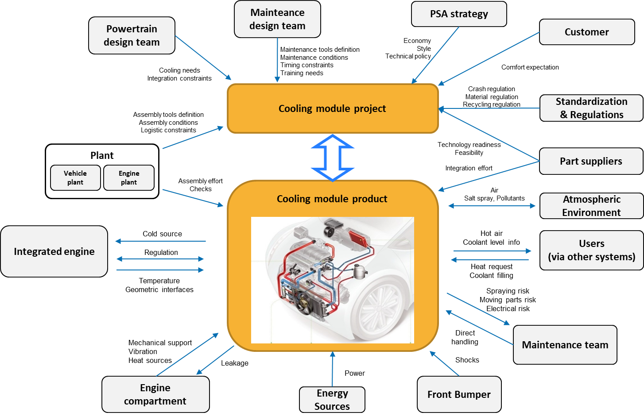
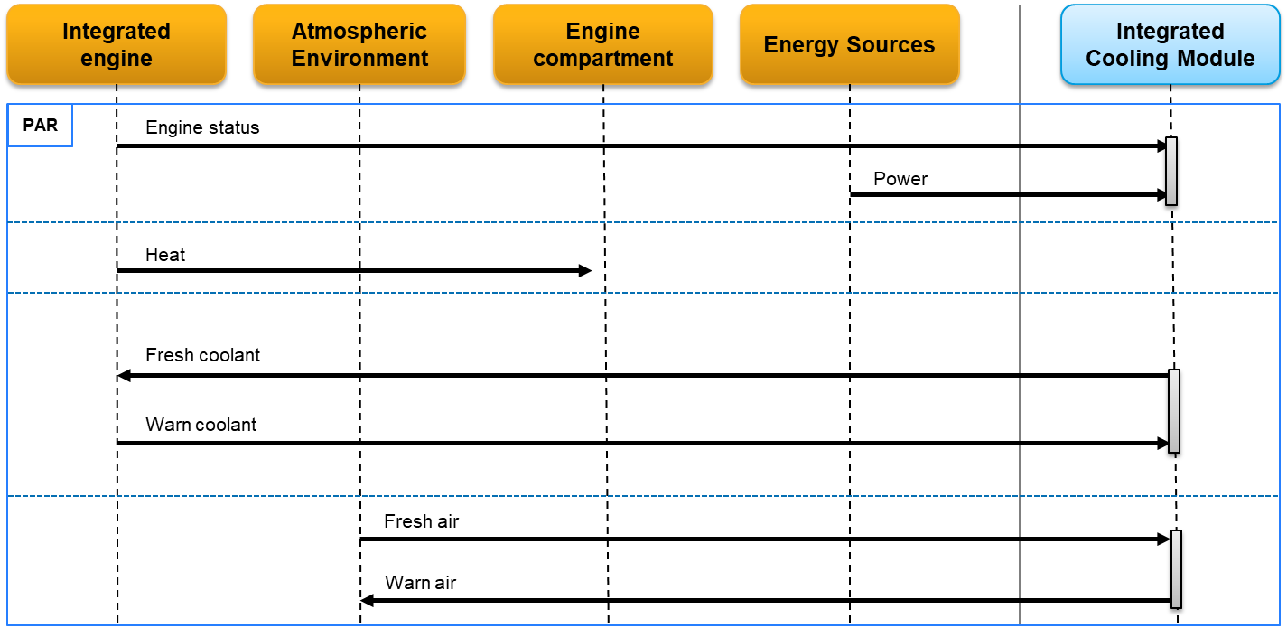
… as the starting point of a “local” detailed operational architecture
3
All details cannot be mentioned on global views. Expertise of the architects teams can sort out the problems by providing a detailed operational architecture study relatively to their perimeter.

Slide 33
Use case analysis concepts Operational scenario
3
External systems
Target system boundary
Target system
Timeline
Time
Integrated cooling module
Operational flow
An operational scenario is a dynamic specification that describes the dynamics of a given lifecycle phase of a system, namely the activities and the external exchanges that cover entirely the considered context.

Slide 34
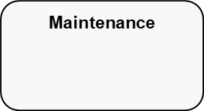
Use case analysis process
3
System lifecycle
Choose
a lifecycle
phase
Lifecycle phase
Step 1
YES
Step 2
Use cases
Step 3
Operational
scenarios
Identify and model use cases
Model operational scenarios
NO
Are there
remaining phases not analysed?
The main phases of the system use case analysis process

Slide 35
Use case analysis – Steps 1&2: chose a lifecycle phase and identify & model use cases (1/2)
3
Vehicle key ON
The considered context
Integrated cooling module
Hint: try to formulate the following sentence
“The [external systems] are using the [system of interest] to [do something]”
A use case related to a lifecycle phase can be described by:
- identifying all external systems that are involved in that lifecycle phase,
- making explicit the uses of the target system by those external systems which are interacting with it during the selected lifecycle phase.

Slide 36
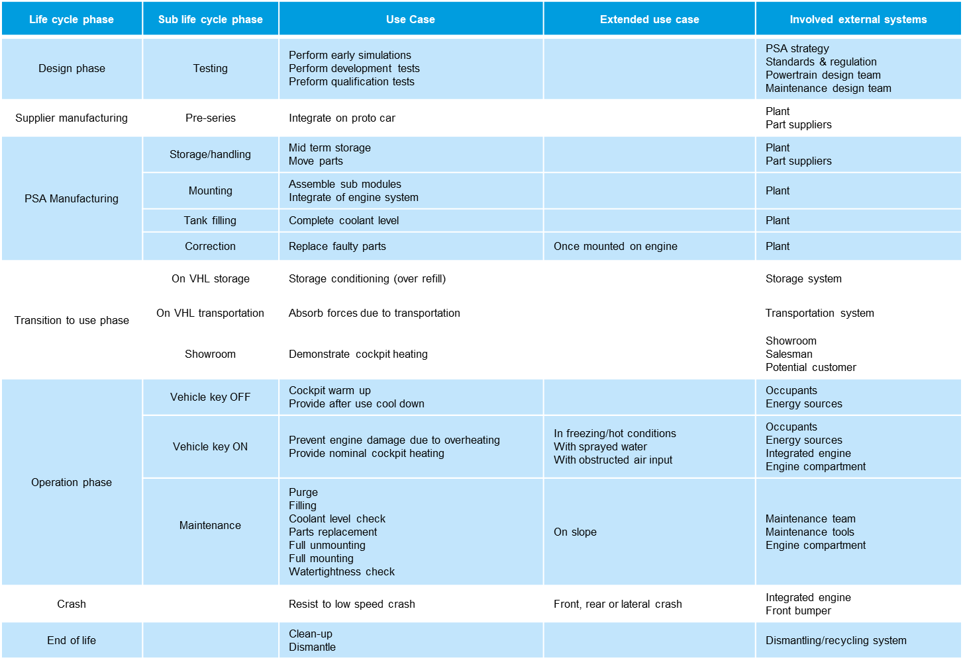
Use case analysis – Steps 1&2: chose a lifecycle phase and identify & model use cases (2/2)
3
A use case diagram is more convenient to share and improve the study, but can be time costly
A use case table gives the global picture but is not collaborative friendly
Having a use case table is mandatory to reflect the coverage of your study, but in some cases, presenting use cases using a diagram is to be preferred.

Slide 37
Use case analysis – Step 3: model operational scenarios (1/2) How to analyze an operational scenario?
3
Target
system
External systems involved in a use case
1
2
3
Identify the systems that are involved in the operational scenario considered
Analyze the chain of activities existing between the systems
Identify the initiating event
An operational scenario of a system describes a chain of activities performed by the target system and a set of external systems which typically capture the dynamic behavior of a given use case (and thus the underlying lifecycle phase).

Slide 38
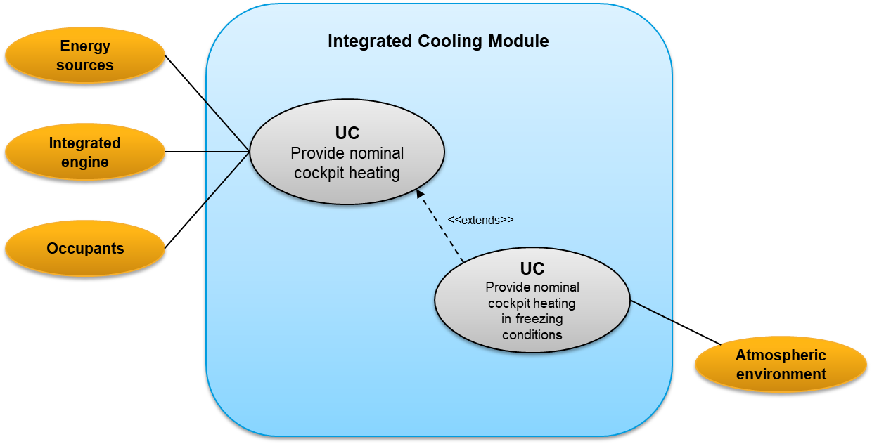
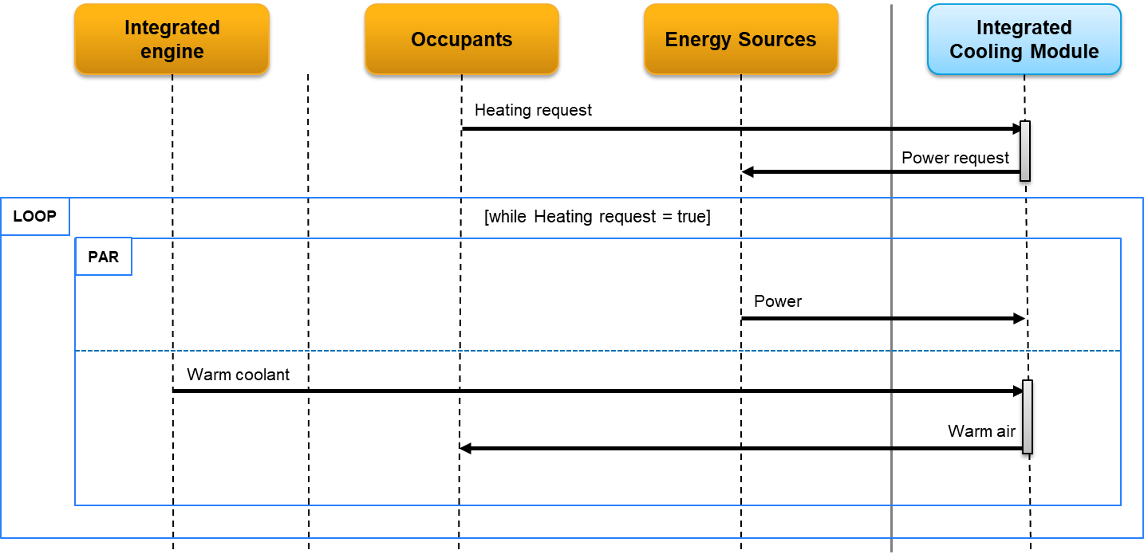
Use case analysis – Step 3: model operational scenarios (2/2) How to formalize an operational scenario?
3
Use case
Provide nominal cockpit heating
Integrated cooling module
Operational scenario
Corresponding dynamic description
The operational scenario associated to a dedicated use case can be built by:
finding all the involved (external & internal) systems,
identifying the first (initiating) event triggering the operational scenario,
analyzing the chain of activities performed by the involved systems and the nature of their exchanged flows during the underlying lifecycle phase.

Slide 39
Some advanced modelling elements
3
External system 1
External system 2
External system n
System of interest
parallel
Operational flow
parallel: allows modelling sequences occurring in parallel
time
Operational flow
loop
[loop condition]
Operational flow
loop: allows modelling repeating sequence depending on a condition
Operational flow
alt
[alt condition]
Operational flow
alt: allows modelling sequences which execution depends on a condition
(if / then / else)
else sequence
Operational flow
ref: calls another use case
ref
Reference to another use case

Slide 40
Relationship with stakeholders requirements engineering
3
The Vehicle Services Architect shall guarantee the maximum Failure probability in use after 15 years / 240000 km of the hazard ERC4-18 (Inopportune steering of the wheels ) is < 10-X.
The marketing imposes a vehicle overall unit cost below XXX € for all its technical configurations.
Covering
The regulations impose that all vehicles respect the ECE regulation when applicable.
Needs
Use cases
The driver shall be able to lock/unlock the overall passenger compartment, front & rear with a mark greater than XXX in the "Park" lifecycle phase.
If needs analyses were properly conducted, no new unidentified lifecycle phase shall be detected further. To confirm this point, it is however useful to go through each use case and to check systematically whether each need is covered by one or several use cases.

Slide 41
Exercise support

Slide 42
Needs architecture & allocation concept Need
3
The Vehicle Services Architect shall guarantee that the maximum failure probability of the hazard ERC4-18 (Inopportune steering of the wheels ) is < 10-X after 15 years / 240,000 km
Stakeholder
Project System
Production and maintenance
Marketing
Vehicle system
The marketing imposes a vehicle overall unitary cost below XXX €
in any configuration.
Driver
The driver shall be able to lock/unlock the overall passenger compartment, front & rear with an efficiency greater than XXX in the "Park" lifecycle phase.
Standards and Regulations
Energy sources
Regulations impose that all vehicles respect the ECE regulation when applicable.
A need relative to a system is an expected or imposed property by one or more external systems of its environment that has a impact on the system

Slide 43
Needs architecture – Step 2: capture and formalize the needs Automotive illustration – Examples of needs
3
The plant imposes that the whole vehicle shall be assembled with respect to safety rules
XXXX and YYYY in mounting phase
The user shall be able to operate the vehicle in Europe, Russia and China in transition to use phase and operating phase
The owner shall be able to use the vehicle with a failure probability of 10^{-x} after 15 years / 240 000 km in operating phase
The regulation imposes all vehicles to respect the UNECE regulation in all phases
Euro NCAP shall be able to deliver a mark of 4/5 at crash tests in design phase
The marketing shall be able to demonstrate a cabin heating efficiency with a mark of 7 (see referential XXX) in operating phase
The marketing imposes a vehicle overall unitary cost below XXX € in manufacturing phase
Groupe PSA strategy imposes the powertrain to reach the performances mentioned in the roadmap XXX, in design phase
Some examples of needs expressed at vehicle system level that might impact the Integrated Cooling Module design

Slide 44
Needs architecture – Step 2: capture and formalize the needs Automotive illustration – Examples of satisfaction criteria
3
Need | Satisfaction criteria
The plant imposes that the whole vehicle has to be assembled with respect to safety rules XXXX and YYYY in « mounting » phase | Design review Safety rules fulfillment assessment
The user shall be able to operate the vehicle in Europe, Russia and China in transition to use phase and operating phase | Climate bench tests
Some examples of satisfaction criteria associated with given needs

Slide 45
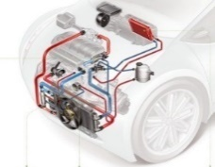
Needs architecture – Step 3: Classify needs into homogeneous sub-assemblies – Automotive illustration
3
Operability
The user shall be able to operate the vehicle in Europe, Russia and China in transition
to use phase and operating phase
Safety
Euro NCAP shall be able to deliver a mark of 4/5 at crash tests in design phase
The plant imposes that the whole vehicle has to be assembled with respect to safety rules XXXX and YYYY in « mounting » phase
Durability
The owner shall be able to use the vehicle with a failure probability of 10^{-x} after 15 years / 240 000 km in operating phase
Performance
Groupe PSA strategy imposes the powertrain to reach the performances mentioned in the roadmap XXX, in design phase
The marketing shall be able to demonstrate a cabin heating efficiency with a mark of 7 (see referential XXX) in operating phase
The marketing imposes a vehicle overall unitary cost below XXX € in manufacturing phase
A possible (partial) classification of needs

